Slide 1
Investigation Task
Year 7 Science

Slide 2

Review:
Explain the difference between an observation, and inference and a prediction.
How can we make an experiment a “fair test”?
Draw a scientific diagram of a measuring cylinder.

Slide 3
Learning Intentions
Collaboratively and individually plan and conduct a range of investigation types, including fieldwork and experiments, ensuring safety and ethical guidelines are followed

Slide 4
Success criteria
Draw a scientific diagram for your experiment
Give your diagram a caption
Record results in a table
Calculate averages from repeat trials

Slide 5
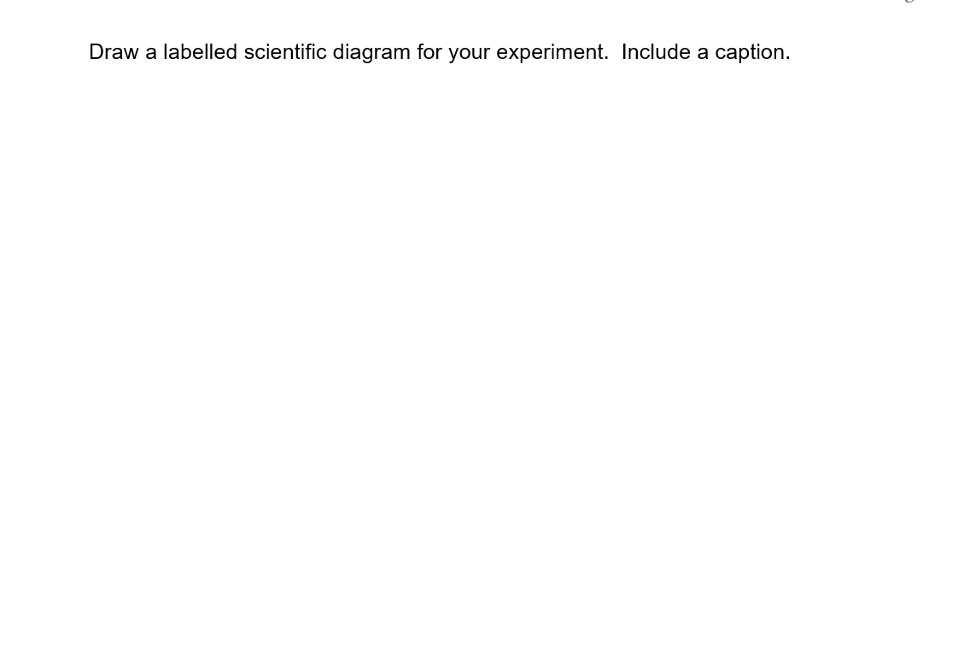
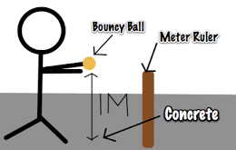
Fig 1: Bouncing balls experiment

Slide 6
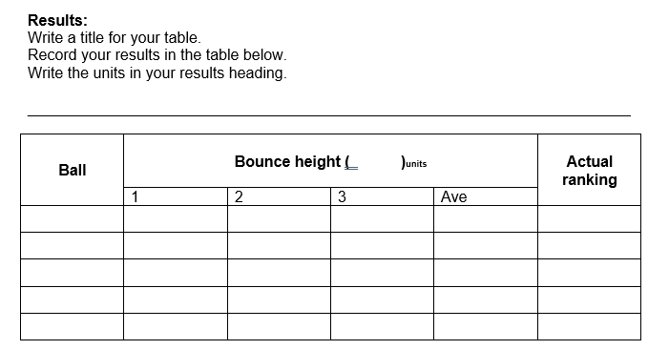

Slide 7
Calculating averages

Slide 8

Don’t forget
Homework sheet – Analysing graphs
Due Monday 26 Feb

